Slide 1
Computer Organization
Yasser F. O. Mohammad

Slide 2
Lecture 1: Introduction
Today’s topics:
Why computer organization is important
Logistics
Modern trends

Slide 3
Why Computer Organization
You must take it … it is in the curriculum
Understanding how is this piece of metal and sand doing all the magic
Understanding what affects the performance of your software
….

Slide 4
Must a Programmer Care About Hardware?
Must know how to reason about program performance
and energy
Memory management: if we understand how/where data
is placed, we can help ensure that relevant data is nearby
Thread management: if we understand how threads
interact, we can write smarter multi-threaded programs
→ Why do we care about multi-threaded programs?

Slide 5
Example
200x speedup for matrix vector multiplication
Data level parallelism: 3.8x
Loop unrolling and out-of-order execution: 2.3x
Cache blocking: 2.5x
Thread level parallelism: 14x

Slide 6
Key Topics
Moore’s Law, power wall
Use of abstractions
Assembly language
Computer arithmetic
Pipelining
Using predictions
Memory hierarchies
Reliability

Slide 7
Logistics
See class web-page
http://www.ii.ist.i.Kyoto-u.ac.jp/~yasser
A mailing list will be created
TAs: TBA
Office hours: Tuesday 12:00~2:00PM
Textbook: Computer Organization and Design
– HW/SW Interface,
Patterson and Hennessy, 5th edition

Slide 8
Course Organization
15% midterm, 70% final, 10% assignments, 15% quizzes
Assignment grading is done by the TA
Co-operation policy: you may discuss – you may not
see someone else’s written material when writing your
solution

Slide 9
Contents to be Covered
Computer Abstraction and Technology : Ch 1
Instructions: Language of Computers : Ch 2 (!)
Arithmetic for Computers : Ch 3
The Processor: Ch 4
Memory Hierarchy: Ch 5 (may be)

Slide 10
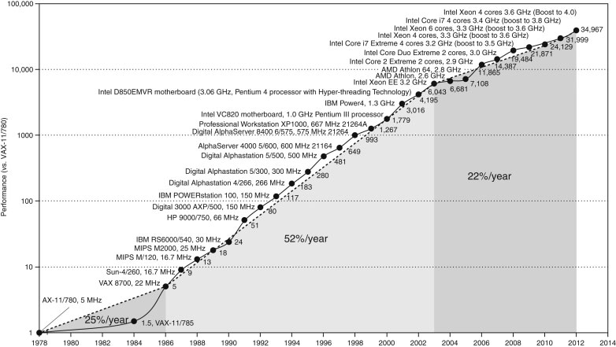
Microprocessor Performance
50% improvement every year!!
What contributes to this improvement?
Source: H&P Textbook

Slide 11
Important Trends
Running out of ideas to improve single thread performance
Power wall makes it harder to add complex features
Power wall makes it harder to increase frequency

Slide 12
Important Trends
Historical contributions to performance:
Better processes (faster devices) ~20%
Better circuits/pipelines ~15%
Better organization/architecture ~15%
In the future, bullet-2 will help little and bullet-1 will
eventually disappear!
Pentium P-Pro P-II P-III P-4 Itanium Montecito
Year 1993 95 97 99 2000 2002 2005
Transistors 3.1M 5.5M 7.5M 9.5M 42M 300M 1720M
Clock Speed 60M 200M 300M 500M 1500M 800M 1800M
Moore’s Law in action
At this point, adding transistors
to a core yields little benefit

Slide 13
What Does This Mean to a Programmer?
Today, one can expect only a 20% improvement; the
improvement is even lower if the program is not
multi-threaded
A program needs many threads
The threads need efficient synchronization and
communication
Data placement in the memory hierarchy is important

Slide 14
Challenges for Hardware Designers
Find efficient ways to
boost single-thread performance
improve data sharing
boost programmer productivity
manage the memory system
build accelerators for important kernels
reduce system energy per instruction

Slide 15
The HW/SW Interface
Application software
a[i] = b[i] + c;
Compiler
lw $15, 0($2)
add $16, $15, $14
add $17, $15, $13
lw $18, 0($12)
lw $19, 0($17)
add $20, $18, $19
sw $20, 0($16)
Systems software
(OS, compiler)
Assembler
Hardware
000000101100000
110100000100010
…

Slide 16
Computer Components
Input/output devices
Secondary storage: non-volatile, slower, cheaper
Primary storage: volatile, faster, costlier
CPU/processor (datapath and control)

Slide 17
Manufacturing Process
Silicon wafers undergo many processing steps so that
different parts of the wafer behave as insulators,
conductors, and transistors (switches)
Multiple metal layers on the silicon enable connections
between transistors
The wafer is chopped into many dies – the size of the die
determines yield and cost

Slide 18
Processor Technology Trends
Shrinking of transistor sizes: 250nm (1997) →
130nm (2002) → 70nm (2008) → 35nm (2014)
Transistor density increases by 35% per year and die size
increases by 10-20% per year… functionality improvements!
Transistor speed improves linearly with size (complex
equation involving voltages, resistances, capacitances)
Wire delays do not scale down at the same rate as
transistor delays

Slide 19
Memory and I/O Technology Trends
DRAM density increases by 40-60% per year, latency has
reduced by 33% in 10 years (the memory wall!), bandwidth
improves twice as fast as latency decreases
Disk density improves by 100% every year, latency
improvement similar to DRAM
Networks: primary focus on bandwidth; 10Mb → 100Mb
in 10 years; 100Mb → 1Gb in 5 years

Slide 20
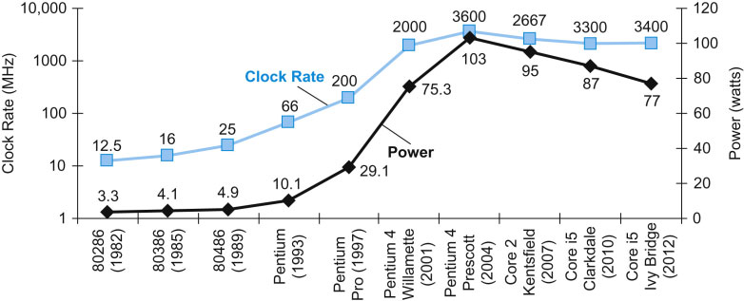
Power Consumption Trends
Dyn power α activity x capacitance x voltage² x frequency
Voltage and frequency are somewhat constant now,
while capacitance per transistor is decreasing and number
of transistors (activity) is increasing
Leakage power is also rising (function of #trans and voltage)
Source: H&P Textbook

